Slide 1
Condition
A condition is an entity that at one point of time can have only one of the two values – true or false. As already pointed out, the IF verb makes use of conditions. In COBOL a condition can be any one of the following:
Relational condition
Sign condition
Class condition
Condition-name condition
Negated simple condition and
Compound condition.

Slide 2
Relational Condition
We know that a relational condition indicates a comparison between two operands and has the form:
Operand-1 relational-operator operand-2
where the relational-operator can be any one of the following:
IS [NOT] GREATER THAN
IS [NOT] > THAN
IS [NOT] LESS THAN
IS [NOT] < THAN
IS [NOT] EQUAL TO
IS [NOT] =

Slide 3
Comparison of Numeric Operands
We are familiar with the kind of relational condition where both the operands are numeric. The comparison in this case is algebraic and the two operands can be compared regardless of the size and USAGE of the fields.
Comparison of Nonnumeric Operands
A nonnumeric operand (identifier/literal other than numeric) can be compared to another nonnumeric operand according to the following rules.
1.) Fields of Equal Sizes
2.) Fields of Unequal Sizes

Slide 4
Comparison of a Numeric Operand
with a Nonnumeric Operand
A numeric operand can be compared to a nonnumeric operand. At the time of comparison, the numeric operand is treated as if its value were moved to an alphanumeric item were then compared to the nonnumeric field.
Group Item as an Operand in Relational Condition
When an operand of a relational condition is a group item, the said item is considered to be an alphanumeric field.
The following examples illustrate the results of different comparisons.

Slide 5
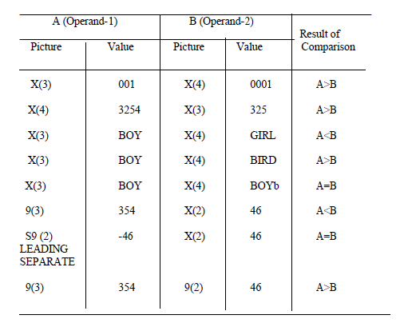

Slide 6
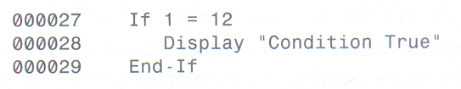
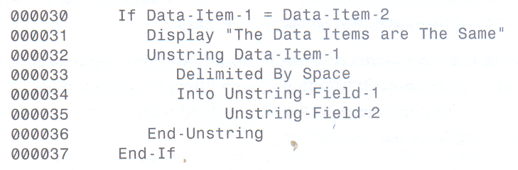




IF Statement
An IF statement may also be terminated with a period. For the structured programming style, only one period per paragraph is used.
The End-If signifies the end of the statements to be executed if the condition being tested is true.
FEU – EAST ASIA COLLEGE
Information Technology Department

Slide 7
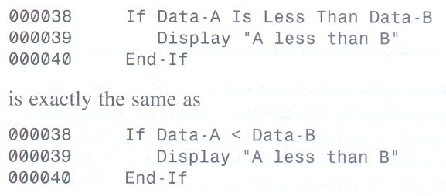
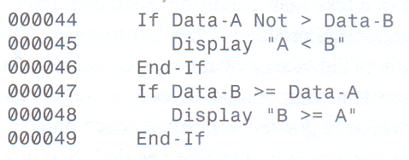

Slide 8
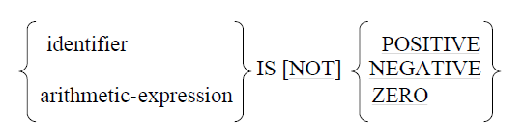
Sign Condition
The sign condition determines whether or not the algebraic value of an operand is positive, negative or zero. The operand can be either a numeric identifier or an arithmetic expression. The format of this condition is as follows:

Slide 9
Example:
It may be noted that the above IF statement is equivalent to the following statement that makes use of a relational condition.
IF BALANCE = 0
GO TO NIL-BALANCE.
Example 2
02 DEPOSIT PIC 9(4) V99.
02 WITHDRAW PIC 9(4) V99.
02 DEPOSIT-WITHDRAW PIC 9(4)V99.
...
IF DEPOSIT-WITHDRAWAL IS POSITIVE
GO TO CALCULATION.

Slide 10
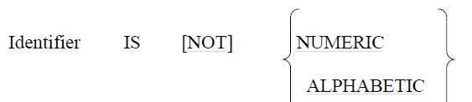
Class Condition
The class condition determines whether or not the value of an operand is numeric or alphabetic. An operand is numeric if it contains only the digits 0 to 9 with or without an operational sign. An operand is alphabetic if it contains only the letters A to Z and space. The format of the class condition is as follows:

Slide 11
Example:
Let BASIC-PAY be a data name in a card record defined with picture
9(5) V99. Having read the card we can test the value of BASIC-PAY to ensure that the data on the card is actually numeric. This can be done as follows
IF BASIC-PAY IS NOT NUMERIC
GO TO PARA-ERROR.
If the data contains any character other than digits, control will be transferred to PARAERROR. Otherwise, control will go to the next sentence in sequence.

Slide 12

Negated Simple Condition

Slide 13
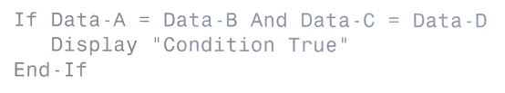
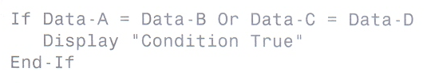
Compound Condition

Slide 14
Compound Condition Abbreviation
Consecutive relational conditions in a compound condition can be abbreviated in certain cases as follows:
1.) When the subjects in the consecutive relational conditions are identical, the subject May be omitted from the one where it appears first.
2.) When the subjects and relational operators in the consecutive relational conditions are Identical, the subject as well as the relational condition may be
omitted, the subject as well as the except from the one where they appear.

Slide 15
Compound Condition Abbreviation
Example 1
AMOUNT > 499 AND AMOUNT < 1000
can be abbreviated to
AMOUNT > 499 AND <1000
Example 2
NOT AGE < 20 AND AGE < 30.
can be abbreviated to
NOT AGE < 20 AND 30

Slide 16
Compound Condition Abbreviation
Example 3
AGE < 30 AND AGE NOT < 20 OR AGE < 40
can be abbreviated to
AGE < 30 AND NOT < 20 OR 40
Example 4
CARD-CODE = 3 OR CARD-CODE = 5 OR CARD-CODE = 7
can be abbreviated to
CARD-CODE = 3 OR 5 OR 7

Slide 17
Conditions-Name Condition
A condition name is an entity which itself is a condition and as such can have either a true or false value. However, a condition name cannot be defined independently. It must always be associated to a data name called the conditional variable.
The condition name may be defined in any section of the DATA DIVISION and must be placed immediately after the entry that defines the conditional variable. There can be more than one condition names associated to a conditional variable. In that case all the condition name entries must follow the entry defining the conditional variable.

Slide 18
88 Levels Example
The following is an example of the use of condition names:
77 MARITAL-STATUS PIC 9.
88 SINGLE VALUE IS ZERO
88 MARRIED VALUE IS 1.
88 WIDOWED VALUE IS 2.
88 DIVORCED VALUE IS 3.
88 ONCE-MARRIED VALUE ARE 1, 2, 3.
VALID-STATUS VALUE ARE 0 THRU 3.

Slide 19
88 Levels Example (cont)
The condition names can be used as conditions. Thus in PROCEDURE DIVISION we may have statements, such as:
IF SINGLE
  SUBTRACT 125 FROM DEDUCTIONS.
IF ONCE-MARRIED
  ADD 32 TO SPECIAL-PAY.
IF NOT VALID–STATUS
  GO TO ERR–IN–STATUS.

Slide 20
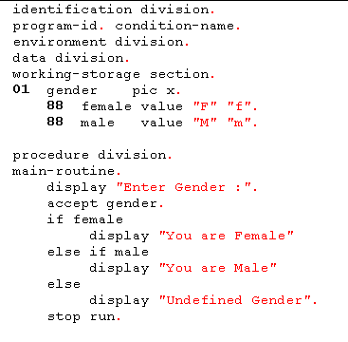
88 Levels Example

Slide 21
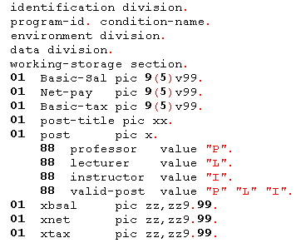
88 Levels Example

Slide 22
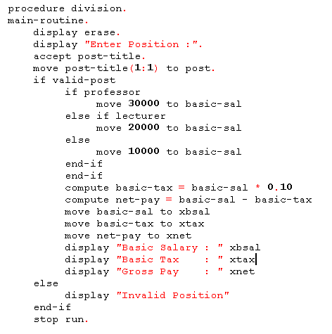

Slide 23
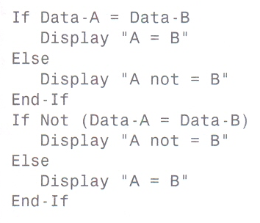
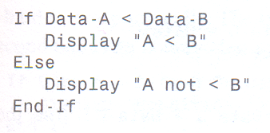
If Else Statement

Slide 24
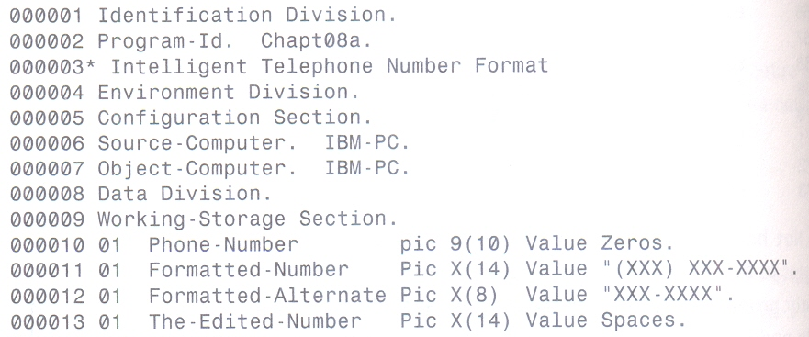
If Else Statement : Sample Code

Slide 25
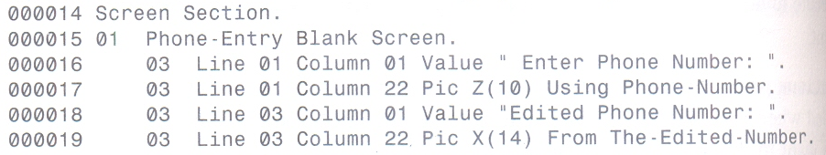
If Else Statement : Sample Code (cont)

Slide 26
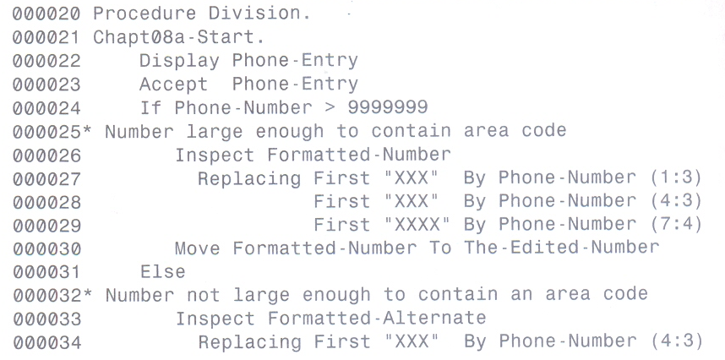
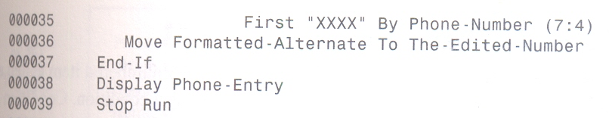
If Else Statement : Sample Code (cont)

Slide 27
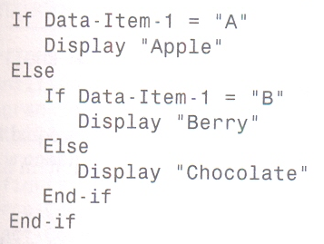
Nested If Statement

Slide 28
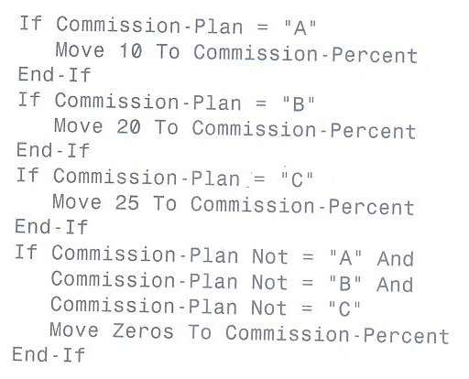
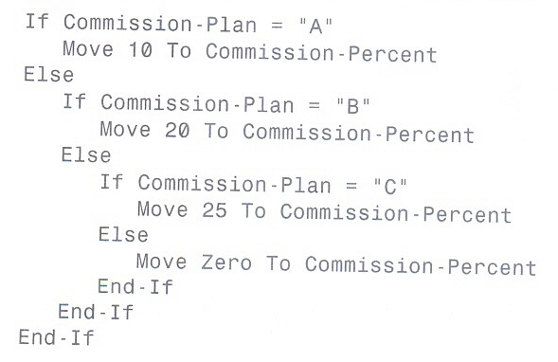
Nested If Statement

Slide 29
